Slide 1


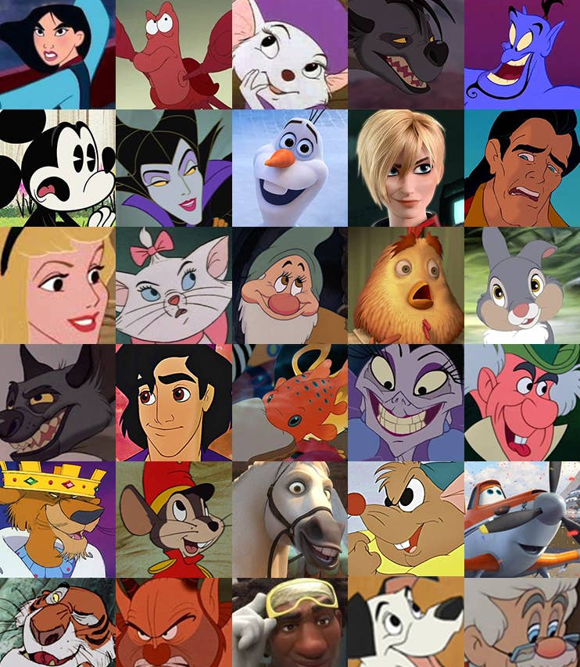
DisneyFamilyUK Instagram Report
Suhana Ahmed

Slide 2

Summary
Outline
High Level Metrics
In-Depth Analysis
Concluding Remarks
Machine Learning Model
Automated Reporting Model
Definitions
Baseline (Pre-Wild) - August - October 2023
Q1- November 2023 - January 2024
Q2 – February- April 2024
Disclaimer: This report pertains to organic activity on the DisneyFamilyUK Instagram account only

Slide 3
Overall: Increased Interactivity & Engagement
+6%
Follower Growth
+15%
Impressions
(per post)
+16%
Reach
(per post)
+33%
Interactions
(per post)
Q1
Q2
Notes:
We have seen moderate growth in impressions reach but quite substantial growth in interactions per post & interactions in general

Slide 4
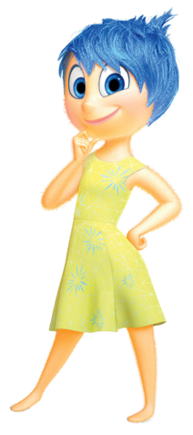
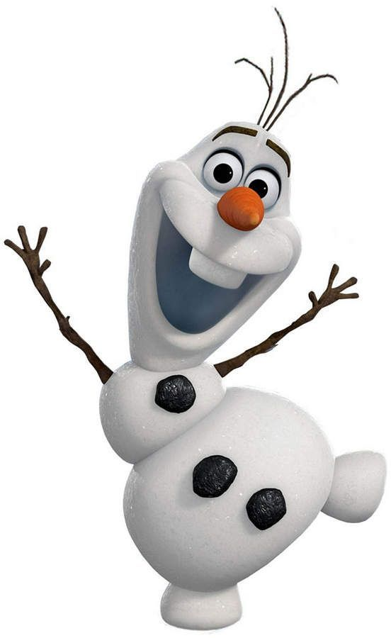
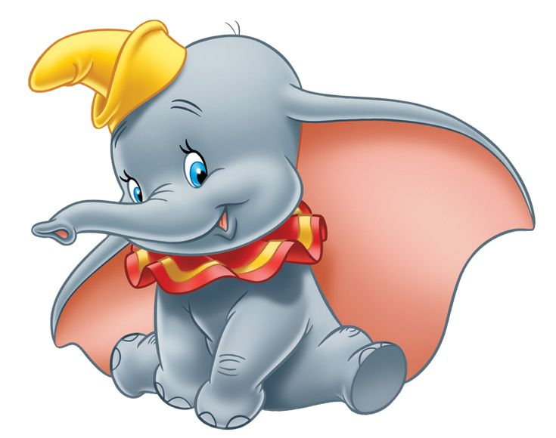
What makes a good Instagram post?

Slide 5
Q2: To ask or not to ask? Hashtags or Questions? Or Both?
Posts with hashtags have higher impressions/reach
Posts with & without hashtags are performing more similarly in Q2
Posts that ask questions have low interactivity
For whole period
Interactions per post: All Inclusive
Questions?
Interactions per post: Wild- Q2
Questions?
False
True
False
True
False
97.5
93.9
False
163.2
No Posts
Hashtag?
Hashtag?
True
151.7
109.3
True
164
117.3
Notes:
We can see a big disparity between not using hashtags between Q2 & all the data. This suggests that we still have high interactivity maybe due to higher engagement/interactivity/more people are seeing it on their feed & want to engage.

Slide 6
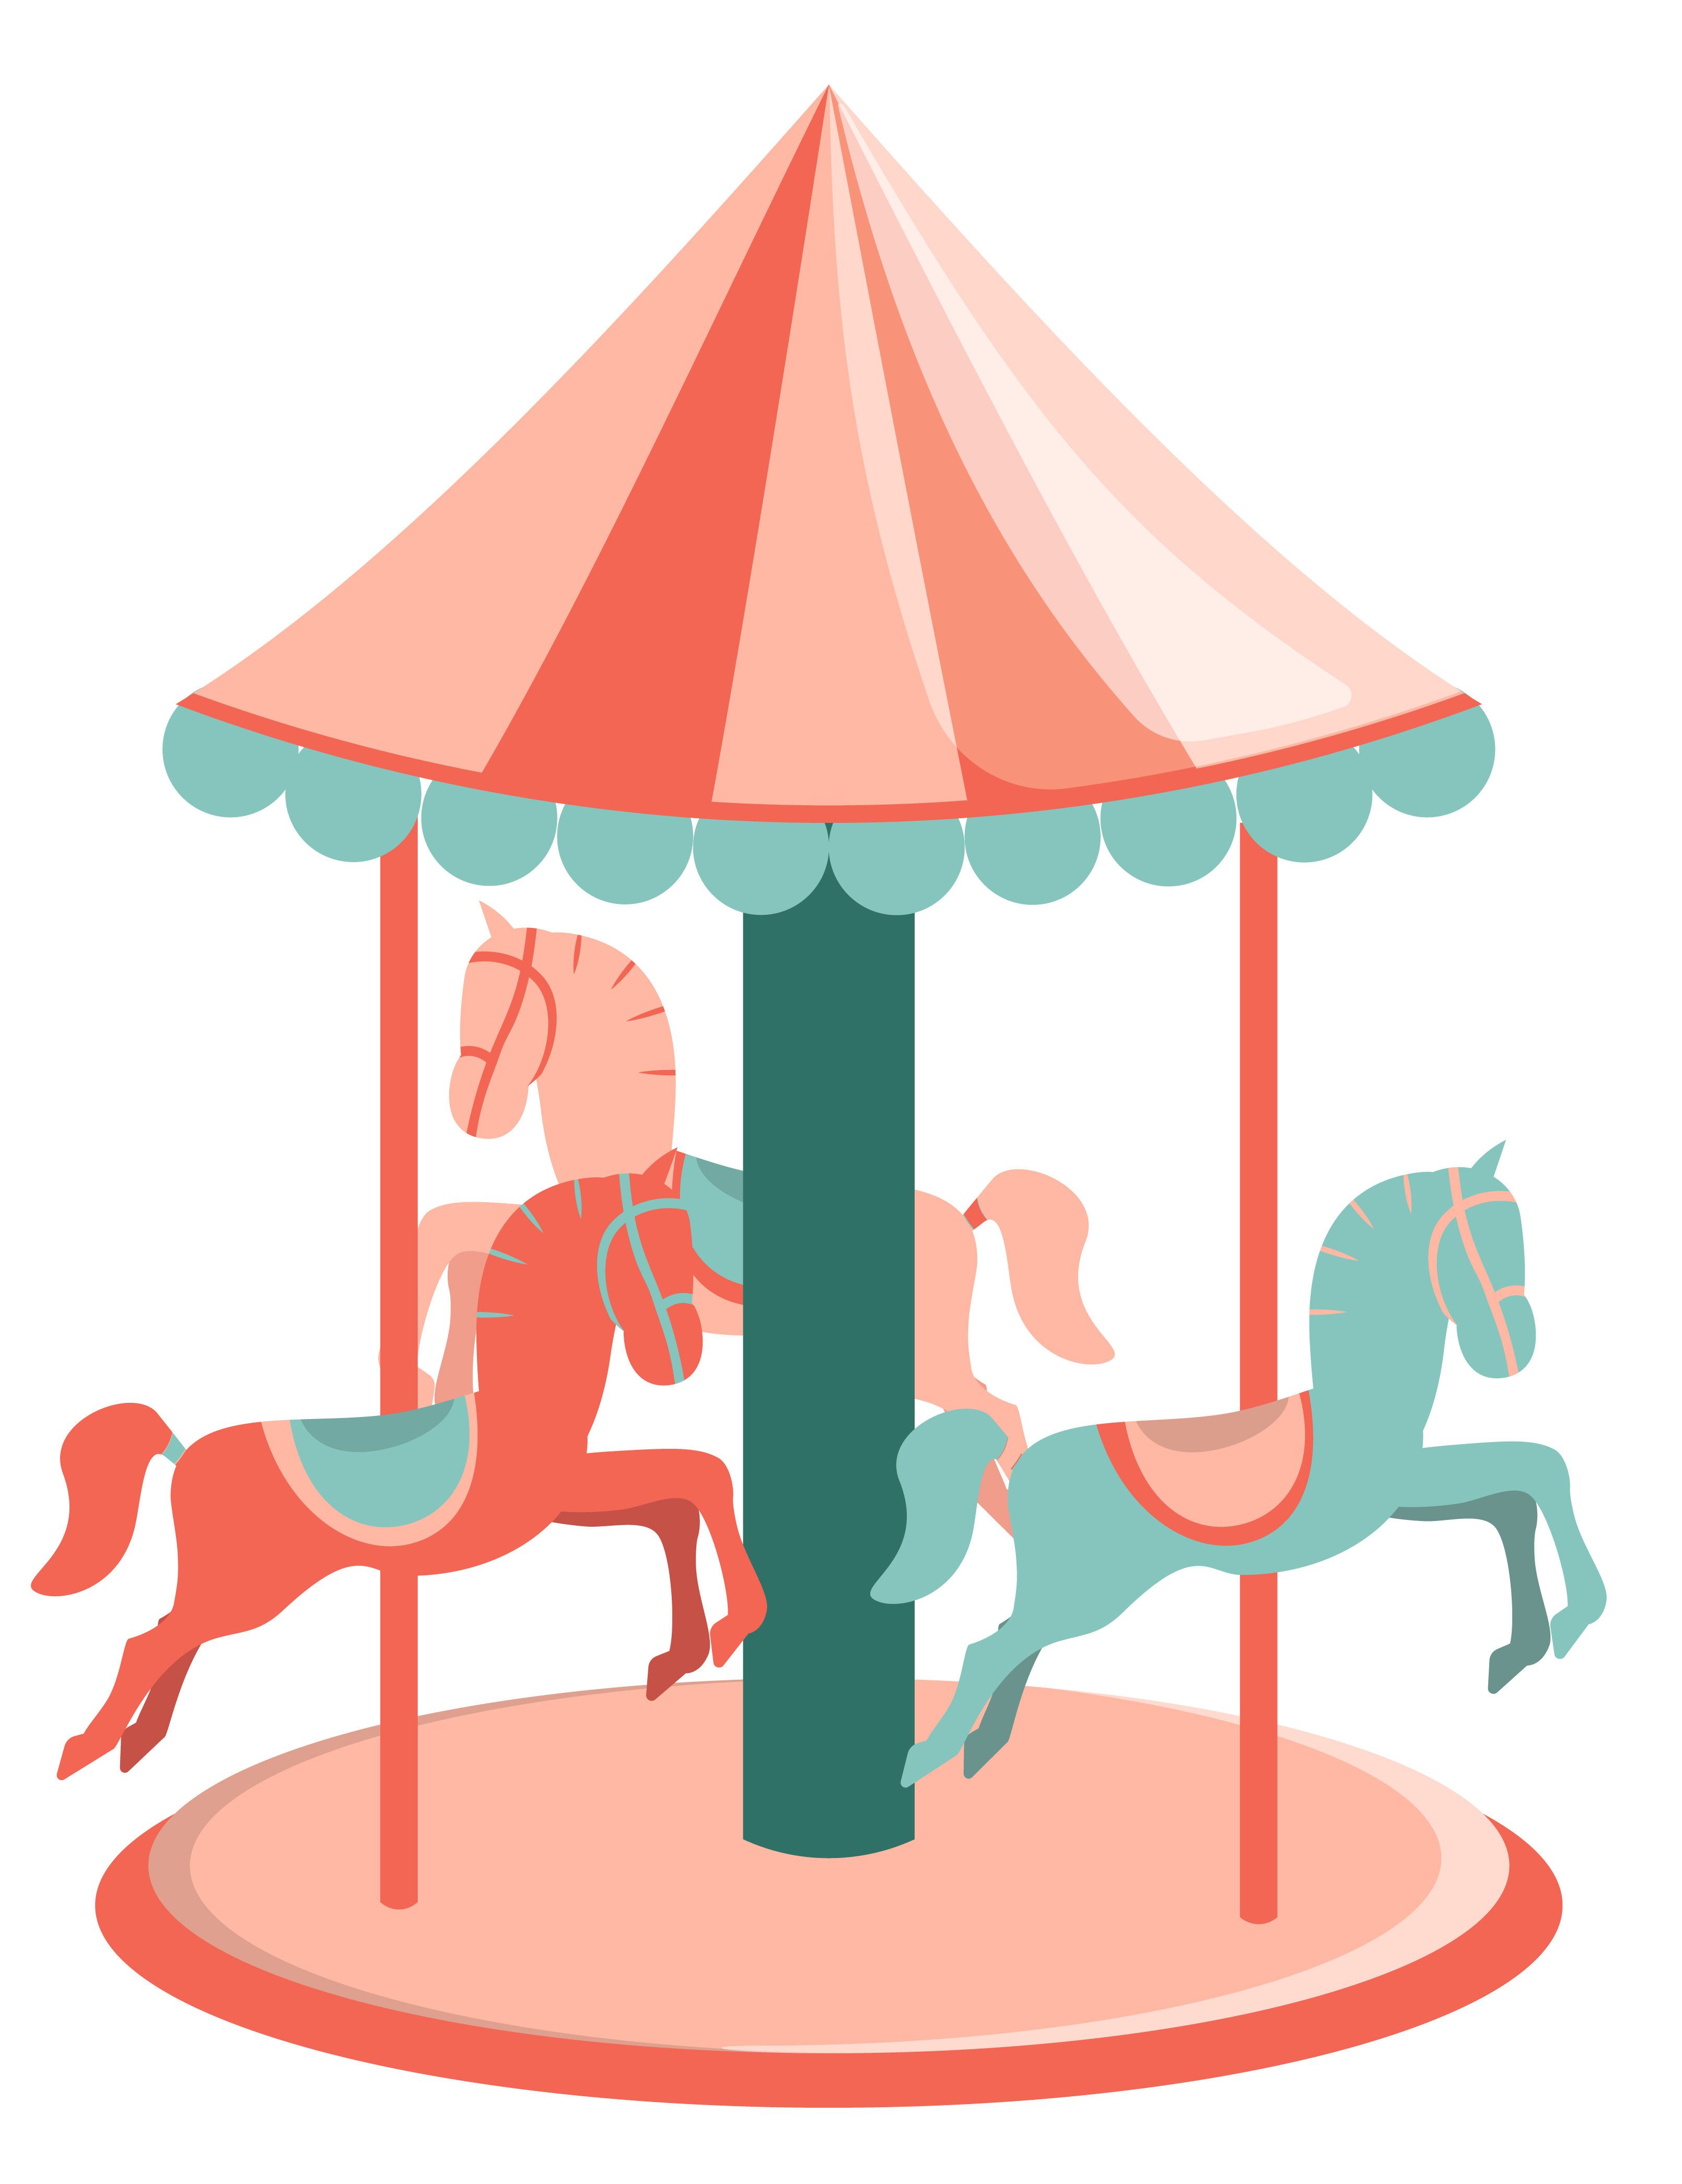
Q2 Media Type: Round the Carousel
Key Findings:
Carousel ads have high reach & interactions, being posted 3 times more in Q2 vs baseline
Reels have 1.5 times more interaction than photos & reels are being posted 2.4 times more than compared to baseline
Reach Engagement Rate % Difference
-11%
Carousel
+52%
Photo
+29%
Reel
Looking at the averages for the whole period inclusive
Comparing averages for engagement rate between baseline period vs Q2 period
Notes:
Video was included in this but there weren’t any likes/share/comment data or reach_engagement data on this?
Carousels are being posted 3 times more compared to baseline but we have seen lower reach engagement for this- need to

Slide 7
Q2 Creative Content: The People Remember
Anniversary
Special Day
+149%
+33%
Interactions per post
+25%
+23%
Reach engagement rate per post
+151%
+33%
Likes per post
+56%
+44%
Comments per post
Averages for the Q2
Calculated by averaging metrics for special day/anniversary then finding & difference between rest of Q2 content
Notes:
We can see that in Q2 anniversary posts tend to do really well- they do well in all metrics aside from shares per post (not sure why)

Slide 8
Interaction Analysis: Let Stay Positive!
-9%
Comments per post
Strongly positive content had 4.93 times more comments than posts with no sentiment in Q2
+61%
Saves per post
Strongly positive content has
2.83 times more engagement overall than posts with no sentiment
+186%
Shares per post
+34%
Likes per post
Comparing averages between baseline period vs Q2 period
Notes:
There was an increase in comments in Q1, Q1 also had a more strongly positive sentiment- so this should be continued.

Slide 9
Q2 Analysis: How are special moments created?
Culturally significant & nostalgic moments
Improve commenting rate & interaction
Follower growth & reach
Continue to capitalise on special days & include relevant hashtags for higher reach.
Tap into nostalgic content more regularly and not just on anniversaries.
Need more content that elicits discussion and is more strongly positive to encourage commenting
Carousels have high interactivity potential which are not currently being optimised
Q2 has focused on engagement & interactions but there needs to be more focus on follower growth & reach
Hash tagging is important here
Notes:
Nostalgia- Not just focus on anniversary posts & incorporate content from older media
Cultural Significant Moments- Continue to capitalise on significant days & include relevant hashtags for higher reach
Comments- Need to engage in more discussion & strongly positive content
Overall- Q2 has adequately focused on engagement & interactions but there needs to be more focus on follower growth & reach

Slide 10


Machine Learning : A model using the data
Internal Team: ‘Hey its International Day of Friendship & I wanted to post a picture for it using a hashtag, can you check what my engagement impressions rate will be like? ‘
Data Analyst: ‘Hey, yes I can, let me run it through my machine learning model, one sec’
Link to Google Colab Sheet- https://colab.research.google.com/drive/13Y_QAMeLGjt9c7d4wwvUIaUw5rRbMQ3k?usp=sharing

Slide 11
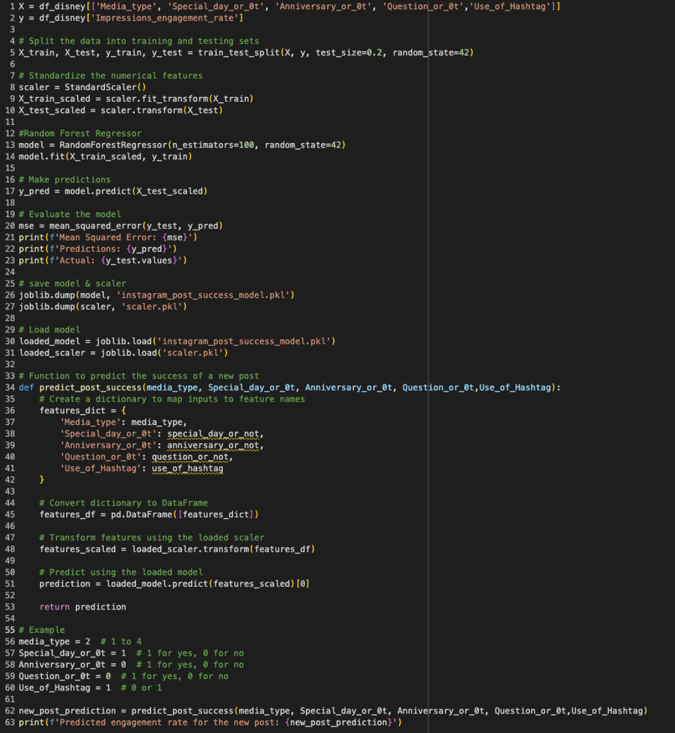

So this is the machine learning model I created using the Random Forest Regressor can predict (with some accuracy) the impressions engagement rate for your post
Here I have let the machine know that you want to post a photo with a hashtag on a special day and your impressions engagement rate is: 0.0384
Notes:
Used Random Forest because it does not require much data to be trained, it can also compute the importance of each feature (from this I found that media type was the most significant factor in calculating impressions engagement rate is media type.
The result of 0.0384 is showing that it will outperform the average for Q2, which is good- the average impressions engagement rate for baseline was 0.0317

Slide 12

Automation & Reporting:
Using automated Python Scripts to come up with data cleaning & visualisations to send out to relevant teams
Emplifi Platform
Install Selenium
Import Pandas
Selenium can download report
Pandas can then clean & format report
Everyone gets reports!!
Import smtplib
Import matplotlib & seaborn
Here the report will be sent out to emails listed
Here we can get visualisations
AP
Agree with different teams what kind of metrics/visualisations would like to be shown
Agree on the frequency of reporting

Slide 13
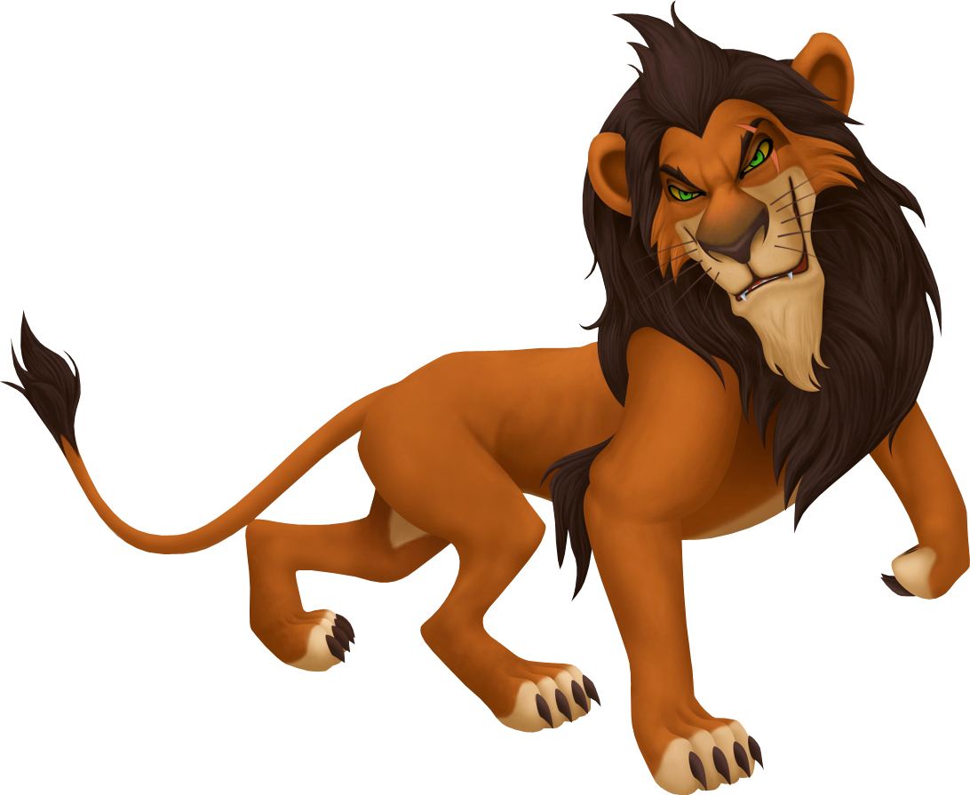

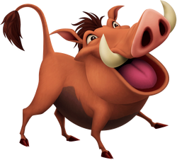
Thank you for listening to my presentation!

